Slide 1
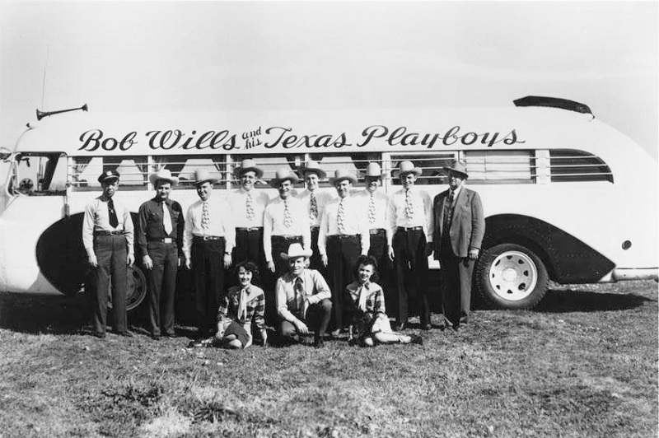
Western Swing and Cowtown
TCU Office of Extended Education
Summer Course 19MM40

Slide 2
Welcome!
Introduce yourself to everyone ☺
What drew you to this course?
Are you familiar with this genre of music?
What do you hope to take away from our experience here?
Course Website:
westernswingandcowtown.educatorgroups.com

Slide 3
Western Swing…what is it?
Came about during the Great Depression era of the 1930s
From Fort Worth, TX!!
A blend of “traditional fiddle breakdowns, country ballads, blues, ragtime, jazz, swing, pop, polkas, schottisches, and other musical styles”
Born out of rural music in Texas, and blended with jazz and swing
Dance music

Slide 4
Western Swing…what is it?
Not country music…let’s listen ☺
Some features of the “quintessential sound” as we know it today
Twin fiddles (or more!)
Steel guitar
Driving rhythm and walking bass lines on guitar
Piano strong in the rhythm section
Early key figures:
The Light Crust Doughboys
Milton Brown & The Musical Brownies
Bob Wills & The Texas Playboys
Spade Cooley

Slide 5
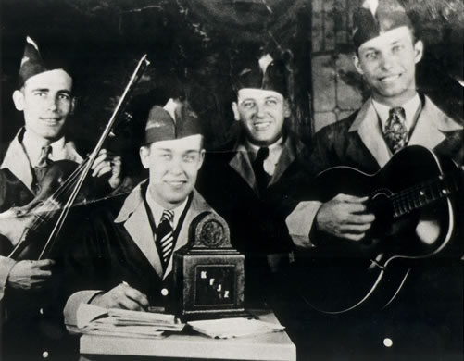
The Light Crust Doughboys

Slide 6
The Light Crust Doughboys
Formed in 1931
“String Band”
Performed on Fort Worth’s KFJZ radio to promote Light Crust Flour (Burrus Mill and Elevator Company)
Milton Brown, Bob Wills, Herman Arnspiger, Derwood Brown
Mixed blues, jazz, ragtime, rural music
Disbanded over disagreements with Wilbert Lee “Pappy” O’Daniel

Slide 7
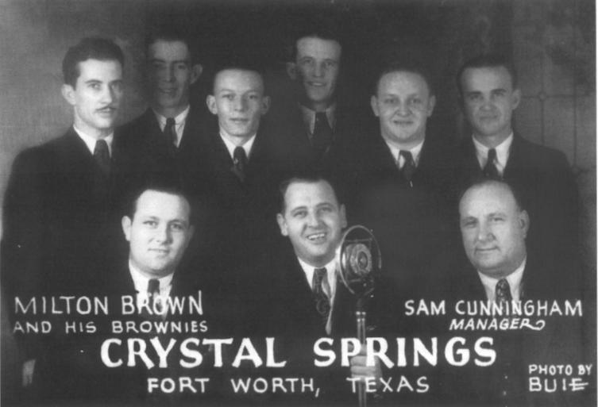
Milton Brown & The Musical Brownies

Slide 8
Milton Brown & The Musical Brownies
Formed in 1932
“The Father of Western Swing”
Played Crystal Springs Dance Hall
Killed in an auto accident in 1936
Innovations:
Added a piano player
Bob Dunn – amplified steel guitar
Defined the early sounds of Western Swing

Slide 9
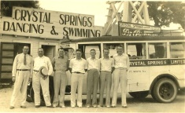
Crystal Springs Dance Hall

Slide 10
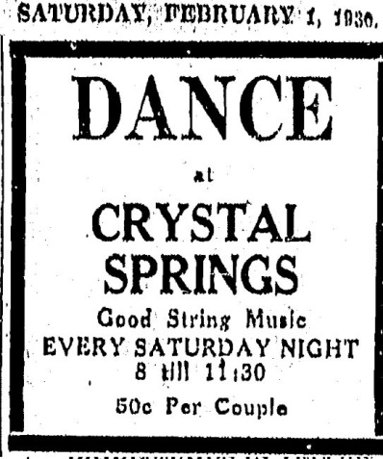
Crystal Springs Dance Hall
5336 White Settlement Rd
Early site of Western Swing dances
Hosted Light Crust Doughboys, Milton Brown, Bob Wills, and many others

Slide 11
Crystal Springs Dance Hall
Filled the pavilion with dancers, sometimes a thousand people
Brown broadcasted from the pavilion
Attendance declined after Brown’s death in 1936
Hosted bands on Saturdays only

Slide 12
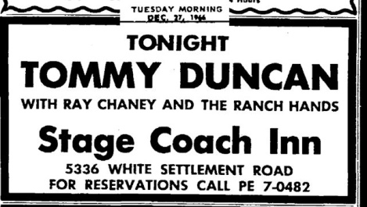
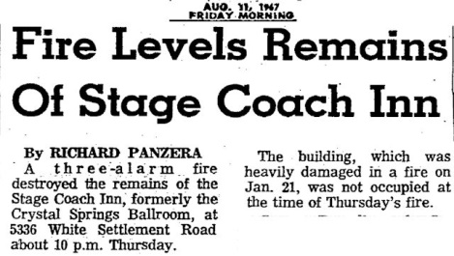
Crystal Springs Dance Hall
1963: becomes Ray Chaney’s Stage Coach Inn
Continued to host western swing and country bands
Fire destroys the club in 1967

Slide 13
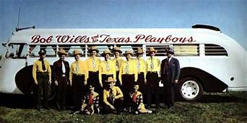
Bob Wills & The Texas Playboys

Slide 14
Bob Wills & The Texas Playboys
Born in Turkey, TX
Met Milton Brown in 1930 in Fort Worth
Left The Musical Brownies in 1933 to form The Texas Playboys
Eventually relocated to Tulsa, and then the West Coast

Slide 15
Bob Wills & The Texas Playboys
“The King of Western Swing”
Helped define the quintessential Western Swing sound we know today
Experimented with his sound over their 40+ years career
Additional fiddles
Horn section in the 40’s/50’s

Slide 16
Bob Wills & The Texas Playboys
Funny Nashville encounter….
Bob defied the Opry rules!
Important recording:
Bob Wills and His Texas Playboys: For the Last Time
Produced by Tommy Allsup
Passed away in 1975

Slide 17
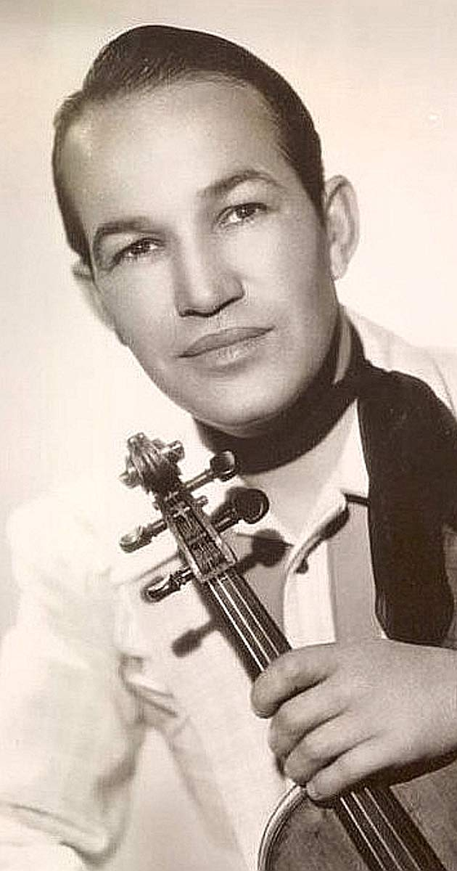
Spade Cooley

Slide 18
Spade Cooley
Born in Oklahoma
Relocated to California in 1930
Defined the “West Coast” Western Swing sound
Once beat Bob Wills in a battle of the bands and called himself the King of Western Swing…hehe.

Slide 19
Spade Cooley
Hired vocalist Tex Williams to front his orchestra, much like Wills/Tommy Duncan
“Refined” sound
Classically influenced violin parts
Harp
Accordion!
More of a west coast rhythm
Excellent musicians

Slide 20
Spade Cooley
“Hollywood’s Western Swing Star”
Stand-in for Roy Rogers
Spade starred in several Western films
Take Me Back To Tulsa
Spade Cooley: King of Western Swing
Melody Stampede and more…

Slide 21
Spade Cooley
Tragically murdered his wife in front of their daughter
Convicted of first-degree murder and sentenced to life in prison
Given a 72-hour furlough to perform a concert in Vacaville; walked offstage to a standing ovation, and died of a heart attack

